Slide 1
10 steps to DevOps Part 1: Modern Debugging
James Tramel
Developer Strategist
james.tramel@microsoft.com
Notes:
a

Slide 2

Every app Every Developer Every Platform
Visual Studio Online
Visual Studio
.NET
Notes:
The tool for everything. .net, sharepoint – web forms.
Mobile development - pokemon
Web Developer – notepad – web extensions
Javascript – typescript angular.
Talking Points
With the increase and diversity of devices there is an opportunity for developers to reach users where they are.
Also with the power of the cloud, infrastructure and capital expenditures no longer have to be a barrier to creating great applications.
Visual Studio 2015 bridges mobile and the cloud by being the first version built to target mobile-first and cloud-first development.

Slide 3
Software delivery challenges
?
Frustration
Delays
Lack of insights

Slide 4
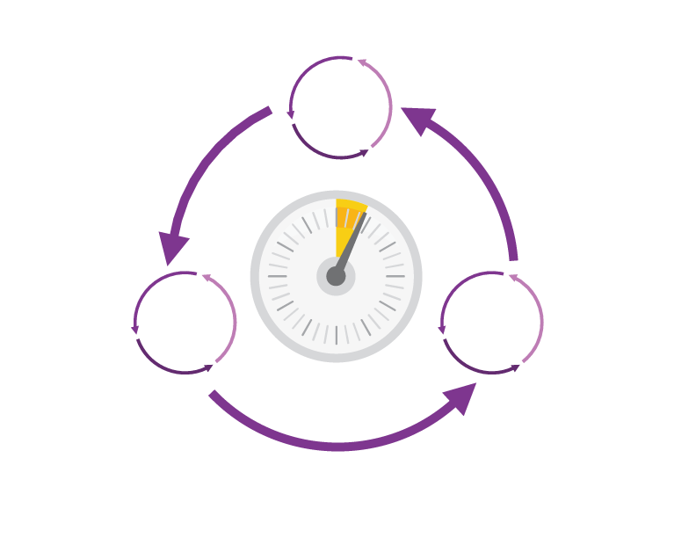
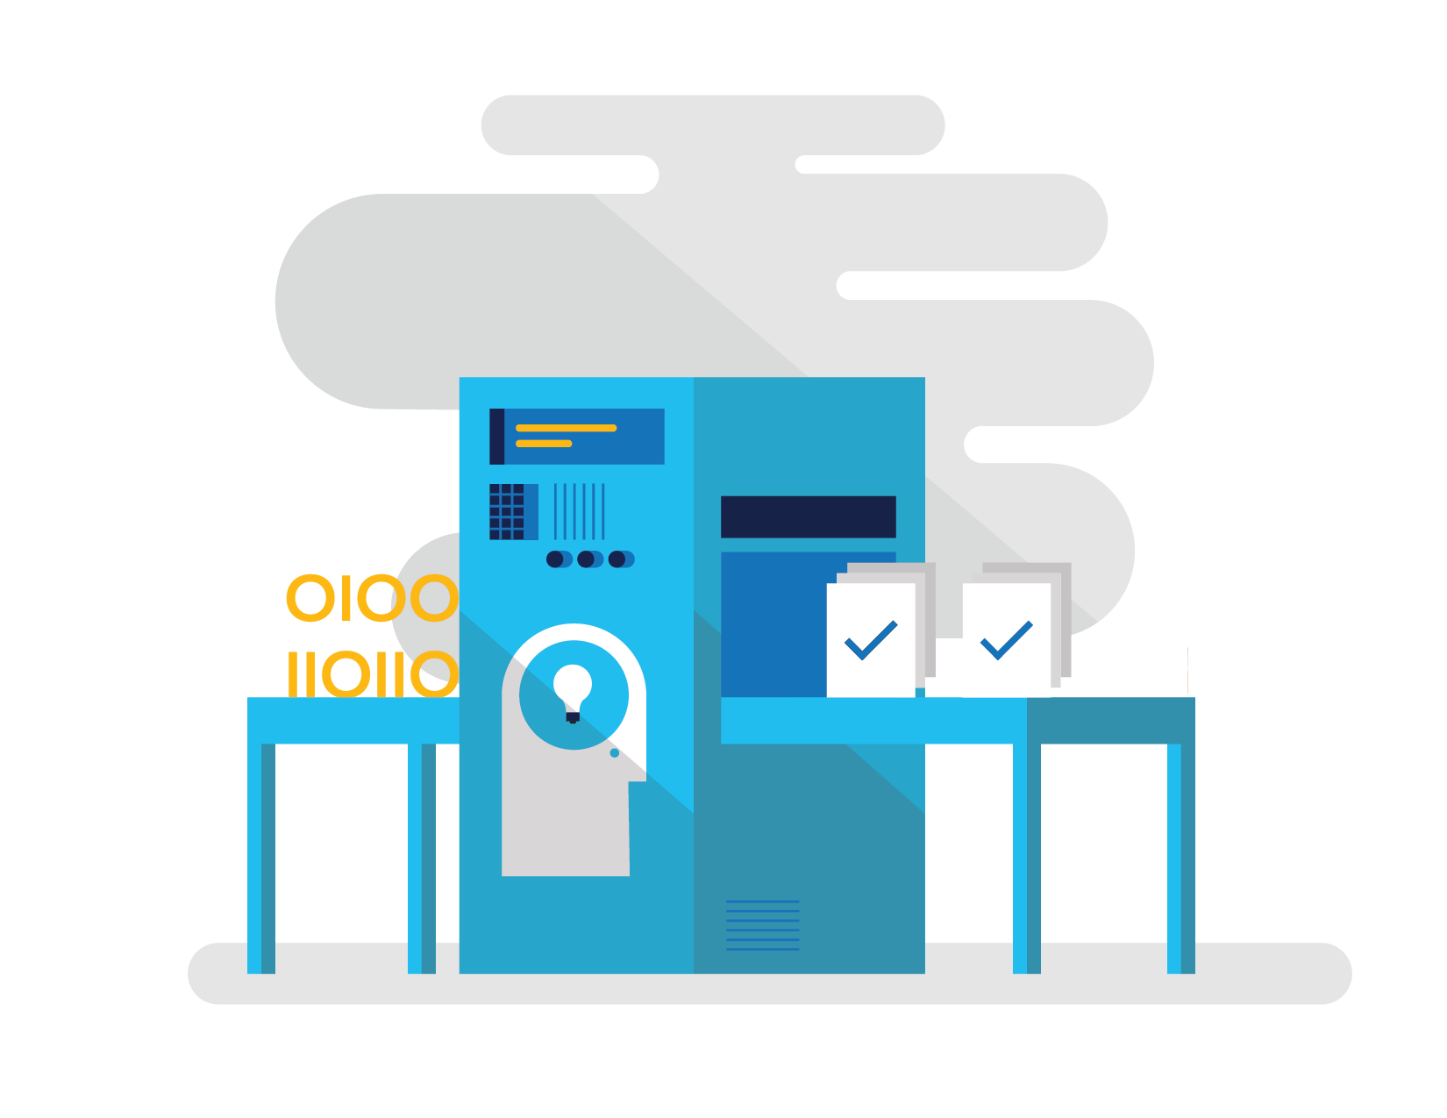

How Microsoft can help
Shorten Cycle Times
Optimize Resources
Improve Quality and Availablilty
Speed up and increase traceability of each release by empowering your development and operations teams with advanced collaboration and automation tools.
Efficiently manage environments using technologies that support self-service provisioning in a secure way, in line with your IT governance standards.
Capture rich telemetry on application performance and usage so that you can make better decisions on future investments and anticipate issues in production before they impact your service.
Visual Studio Team Services
Microsoft Azure
Visual Studio
Notes:
The Microsoft DevOps Solution provides a comprehensive set of software, cloud services, and other essential resources that help you deliver higher-quality software faster with less risk.
This solution is focused on addressing the most pressing challenges of the modern application lifecycle:
Shortening cycle times through advanced release management and automation tools
Optimizing resources and eliminating waste, and
Increasing quality and availability of your solutions

Slide 5






DevOps: the three components
DEV
OPS
1
People
2
Process
3
Products
Notes:
DevOps is the union of people, process, and products to enable continuous delivery of value to our end users.”\\
Focus today, from me, is process and products. Will focus on the how. The people is you. Be the change you want to see.

Slide 6
DevOps
1
4
Plan
Monitor + Learn
Development
Production
2
3
Develop + Test
Release

Slide 7




Visual Studio Enterprise – the tool for DevOps
Optimized for enterprise-class development
An integrated, end-to-end solution for teams of any size with demanding quality and scale needs. Take advantage of comprehensive tools and services for designing, building and managing complex enterprise solutions.
Greater productivity for enterprise application development and delivery
Plan, execute and monitor your entire quality effort, continuously
Manage complexity and close
the loop between Dev and Ops
Notes:
The tool for everything. .net, sharepoint – web forms.
Web Developer – notepad – web extensions
Javascript – typescript angular.

Slide 8
DevOps habits and practices
BACKLOG refined with LEARNING
MANAGED TECHNICAL DEBT
PRODUCTION FIRST MINDSET
INFRA-STRUCTURE is a FLEXIBLE RESOURCE
TEAM AUTONOMY & ENTERPRISE ALIGNMENT
EVIDENCE gathered in PRODUCTION
FLOW OF CUSTOMER VALUE

Slide 9
DevOps habits and practices
LEARN
Application Performance Management
Infrastructure as Code
Continuous Deployment
Release Management
Configuration Management
Automated Recovery
PLAN
Source Control
Stakeholder Feedback
Kanban
Bug Tracking
TEST
Application Performance Management
Usage Monitoring
Telemetry Collection Testing in Production
Stakeholder Feedback
APPROVE
Feature flags
Code Reviews
Automated Testing
Continuous Measurement
BACKLOG refined with LEARNING
MANAGED TECHNICAL DEBT
PRODUCTION FIRST MINDSET
INFRA-STRUCTURE is a FLEXIBLE RESOURCE
TEAM AUTONOMY & ENTERPRISE ALIGNMENT
EVIDENCE gathered in PRODUCTION
FLOW OF CUSTOMER VALUE
APP
Automated Testing
Code Review
Technical Debt
Continuous Integration
Continuous Deployment
Release Management
iNFRA
Automated Enviornment De Provision
Self Service Enviornment
Auotmated Recovery
MONITOR
Infrastructure as Code
Continuous Delivery
Release Management
Configuration Management
Automated Recovery
Testing in Production
Usage Monitoring
User Telemetry
Notes:
Automated Testing
Continuous Integration
Continuous Deployment
Release Management
Usage Monitoring
Telemetry Collection
Testing in Production
Application Performance Management
Infrastructure as Code
Continuous Delivery
Release Management
Change / Configuration Management
Automated Recovery
Load Testing
Avaialability Monitoring
Capactiy Management
Automated Enviornment De Provision
Self Service Enviornment
Auotmated Recovery (roll back / roll forward)
Stakeholder Feedback
Feature flags
Code Reviews / Technical Debt

Slide 10
Dev Ops Skill Katas
Modern Debugging
Automated Unit Testing and Architectural mapping
Work item / bug tracking
Integrated testing / technical debt management
Continuous configuration / package management
Continuous deployment / integration
Release management
Dev / test environments
Infrastructure as code
Monitor and analyze
Notes:
Social club – intellitrace – works on anything .net
Taxation – intellitest and code maps
Sonar qube – vstsdemo – my shuttle 2 – myshuttle ci
https://sonarqube.com/, click rules
Package manager – parts unlimited – build – surreal engine – show feeds
Continuous integration – click on triggersin a build
Continuous deployment – parts unlimited
http://partsunlimited.azurewebsites.net/
Show deployment slots
Azurejut – dupont welcome -
Release – show Aramark azurejt
IAC – show github repo
Show create a new resource
https://github.com/Azure/azure-quickstart-templates
Dev test labs – en portal
Monitor and analytiz – so java portal or farkacam on my portal

Slide 11
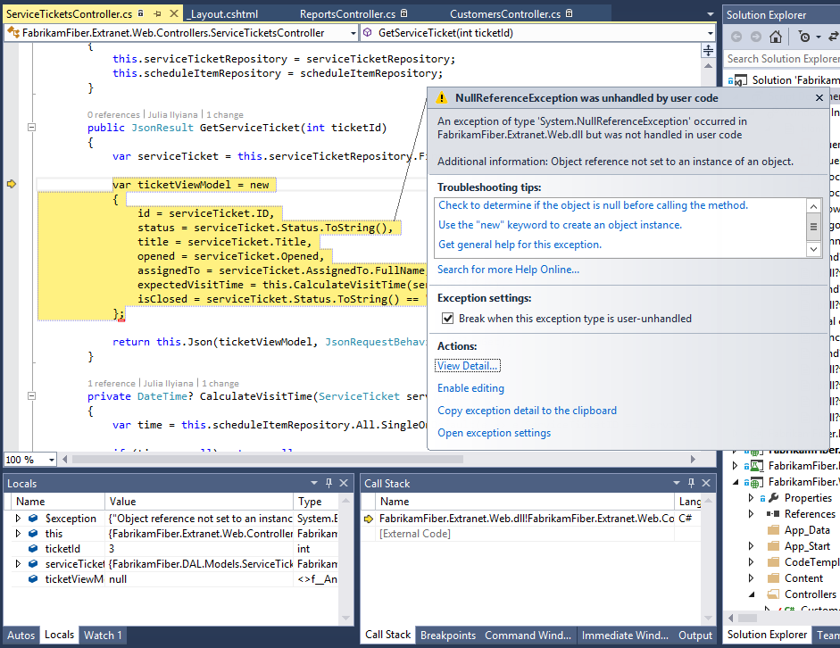
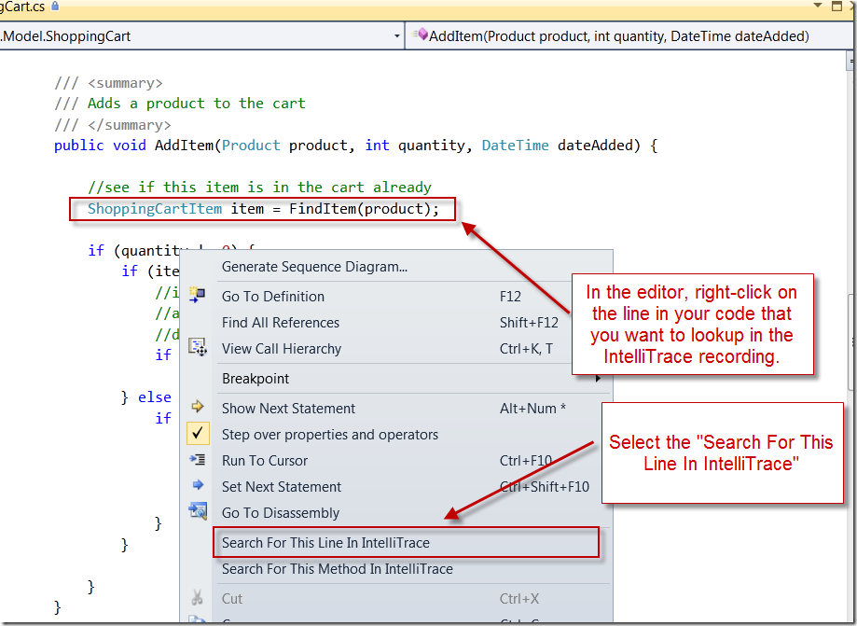
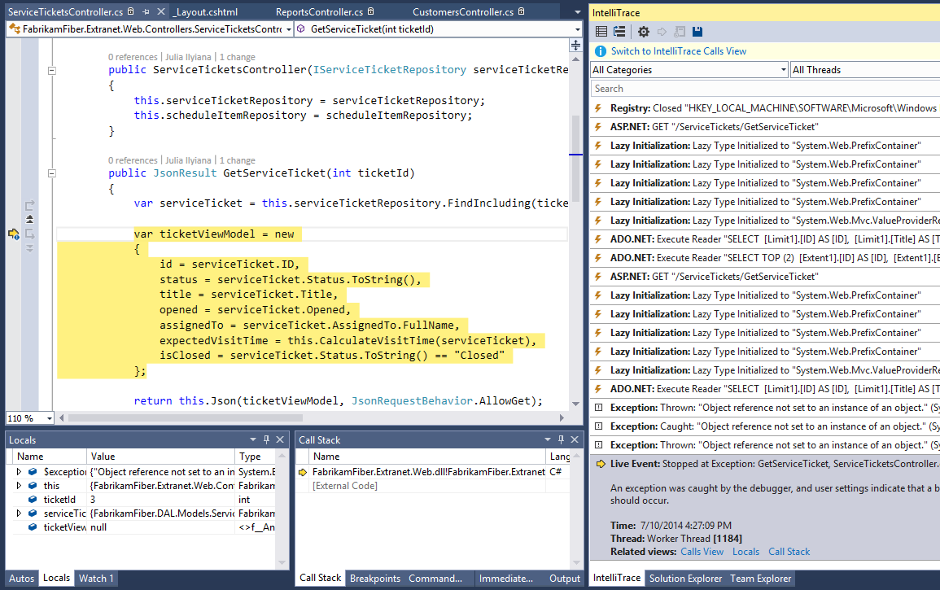
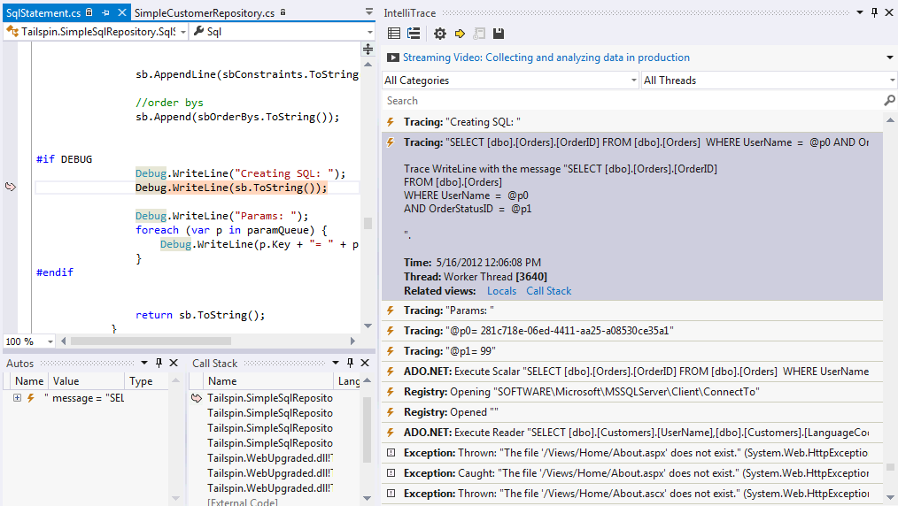
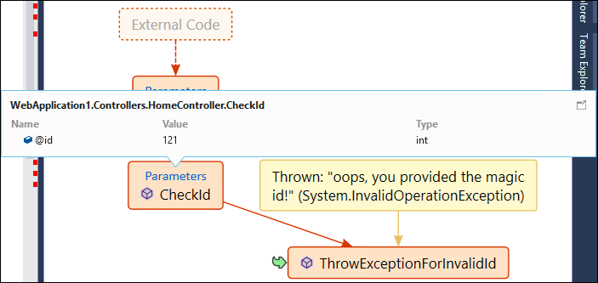
IntelliTrace:
Local
Before
After
Inject Traces
Build Code Maps
Search for Code
Notes:
Debug it, even when it’s history. IntelliTrace™ enables you to capture application execution—including file and registry access, exceptions, method calls, and other state information—whether debugging locally or inspecting a production issue, so you can fix it and release the fix quickly.
Spend less time debugging your app when you record and trace through its execution history with IntelliTrace in Visual Studio Ultimate. This helps you find bugs more easily without setting lots of breakpoints because IntelliTrace lets you:
Record specific events that happened in your app.
You can examine related code, data that appears in the Locals window during debugger events, and function call information, if you choose to collect it.
Reduce restarting your app to recreate bugs or events.
Debug errors that are hard to reproduce or that
IntelliTrace: You can configure the diagnostic data adapter for IntelliTrace to collect specific diagnostic trace information to help isolate bugs that are difficult to reproduce. This creates an IntelliTrace file that contains this information. An IntelliTrace file has an extension of .iTrace. When a test fails, you can create a bug. The IntelliTrace file that is saved together with the test results is automatically linked to this bug. The data that is collected in the IntelliTrace file increases debugging productivity by reducing the time that is required to reproduce and diagnose an error in the code. From this IntelliTrace file the local session can be simulated on another computer. This reduces the risk of a bug being non-reproducible.
happen in deployment.

Slide 12
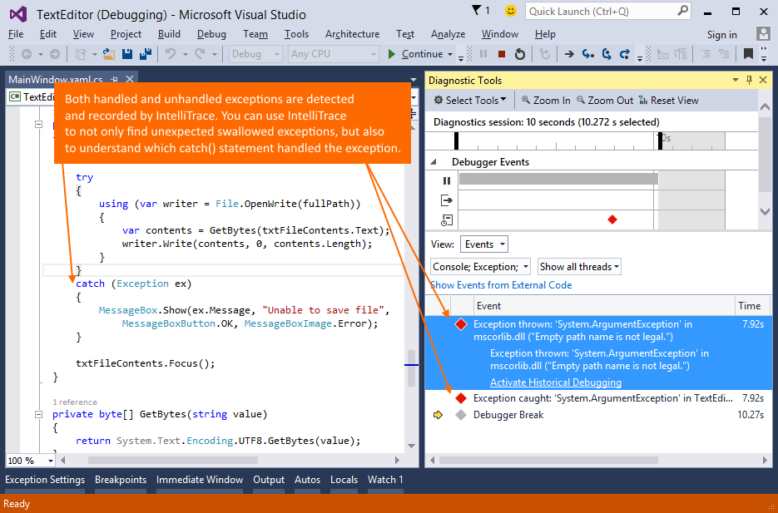
IntelliTrace:
Local
Exceptions
ADO.NET
Console output & Tracing
Inject Traces
Build Code Maps
Search for Code
Notes:
Debug it, even when it’s history. IntelliTrace™ enables you to capture application execution—including file and registry access, exceptions, method calls, and other state information—whether debugging locally or inspecting a production issue, so you can fix it and release the fix quickly.
Spend less time debugging your app when you record and trace through its execution history with IntelliTrace in Visual Studio Enterprise. This helps you find bugs more easily without setting lots of breakpoints because IntelliTrace lets you:
Record specific events that happened in your app.
You can examine related code, data that appears in the Locals window during debugger events, and function call information, if you choose to collect it.
Reduce restarting your app to recreate bugs or events.
Debug errors that are hard to reproduce or that
IntelliTrace: You can configure the diagnostic data adapter for IntelliTrace to collect specific diagnostic trace information to help isolate bugs that are difficult to reproduce. This creates an IntelliTrace file that contains this information. An IntelliTrace file has an extension of .iTrace. When a test fails, you can create a bug. The IntelliTrace file that is saved together with the test results is automatically linked to this bug. The data that is collected in the IntelliTrace file increases debugging productivity by reducing the time that is required to reproduce and diagnose an error in the code. From this IntelliTrace file the local session can be simulated on another computer. This reduces the risk of a bug being non-reproducible.
happen in deployment.

Slide 13
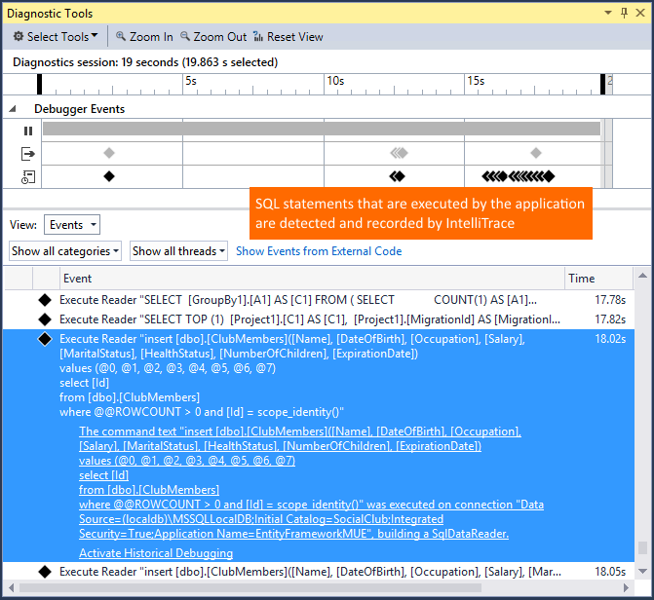
IntelliTrace:
Local
Exceptions
ADO.NET
Console output & Tracing
Inject Traces
Build Code Maps
Search for Code
Notes:
Debug it, even when it’s history. IntelliTrace™ enables you to capture application execution—including file and registry access, exceptions, method calls, and other state information—whether debugging locally or inspecting a production issue, so you can fix it and release the fix quickly.
Spend less time debugging your app when you record and trace through its execution history with IntelliTrace in Visual Studio Enterprise. This helps you find bugs more easily without setting lots of breakpoints because IntelliTrace lets you:
Record specific events that happened in your app.
You can examine related code, data that appears in the Locals window during debugger events, and function call information, if you choose to collect it.
Reduce restarting your app to recreate bugs or events.
Debug errors that are hard to reproduce or that
IntelliTrace: You can configure the diagnostic data adapter for IntelliTrace to collect specific diagnostic trace information to help isolate bugs that are difficult to reproduce. This creates an IntelliTrace file that contains this information. An IntelliTrace file has an extension of .iTrace. When a test fails, you can create a bug. The IntelliTrace file that is saved together with the test results is automatically linked to this bug. The data that is collected in the IntelliTrace file increases debugging productivity by reducing the time that is required to reproduce and diagnose an error in the code. From this IntelliTrace file the local session can be simulated on another computer. This reduces the risk of a bug being non-reproducible.
happen in deployment.

Slide 14
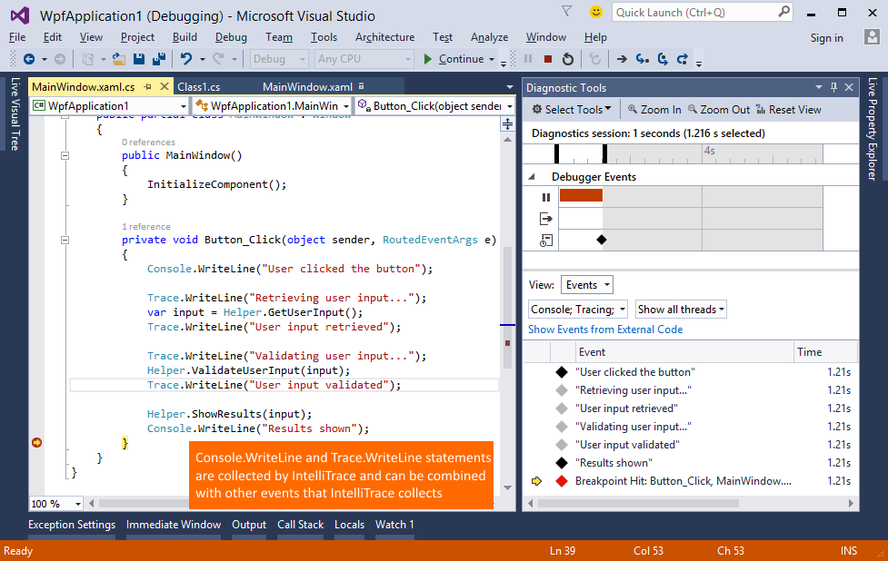
IntelliTrace:
Local
Exceptions
ADO.NET
Console output & Tracing
Build Code Maps
Search for Code
Notes:
Debug it, even when it’s history. IntelliTrace™ enables you to capture application execution—including file and registry access, exceptions, method calls, and other state information—whether debugging locally or inspecting a production issue, so you can fix it and release the fix quickly.
Spend less time debugging your app when you record and trace through its execution history with IntelliTrace in Visual Studio Enterprise. This helps you find bugs more easily without setting lots of breakpoints because IntelliTrace lets you:
Record specific events that happened in your app.
You can examine related code, data that appears in the Locals window during debugger events, and function call information, if you choose to collect it.
Reduce restarting your app to recreate bugs or events.
Debug errors that are hard to reproduce or that
IntelliTrace: You can configure the diagnostic data adapter for IntelliTrace to collect specific diagnostic trace information to help isolate bugs that are difficult to reproduce. This creates an IntelliTrace file that contains this information. An IntelliTrace file has an extension of .iTrace. When a test fails, you can create a bug. The IntelliTrace file that is saved together with the test results is automatically linked to this bug. The data that is collected in the IntelliTrace file increases debugging productivity by reducing the time that is required to reproduce and diagnose an error in the code. From this IntelliTrace file the local session can be simulated on another computer. This reduces the risk of a bug being non-reproducible.
happen in deployment.

